Slide 1
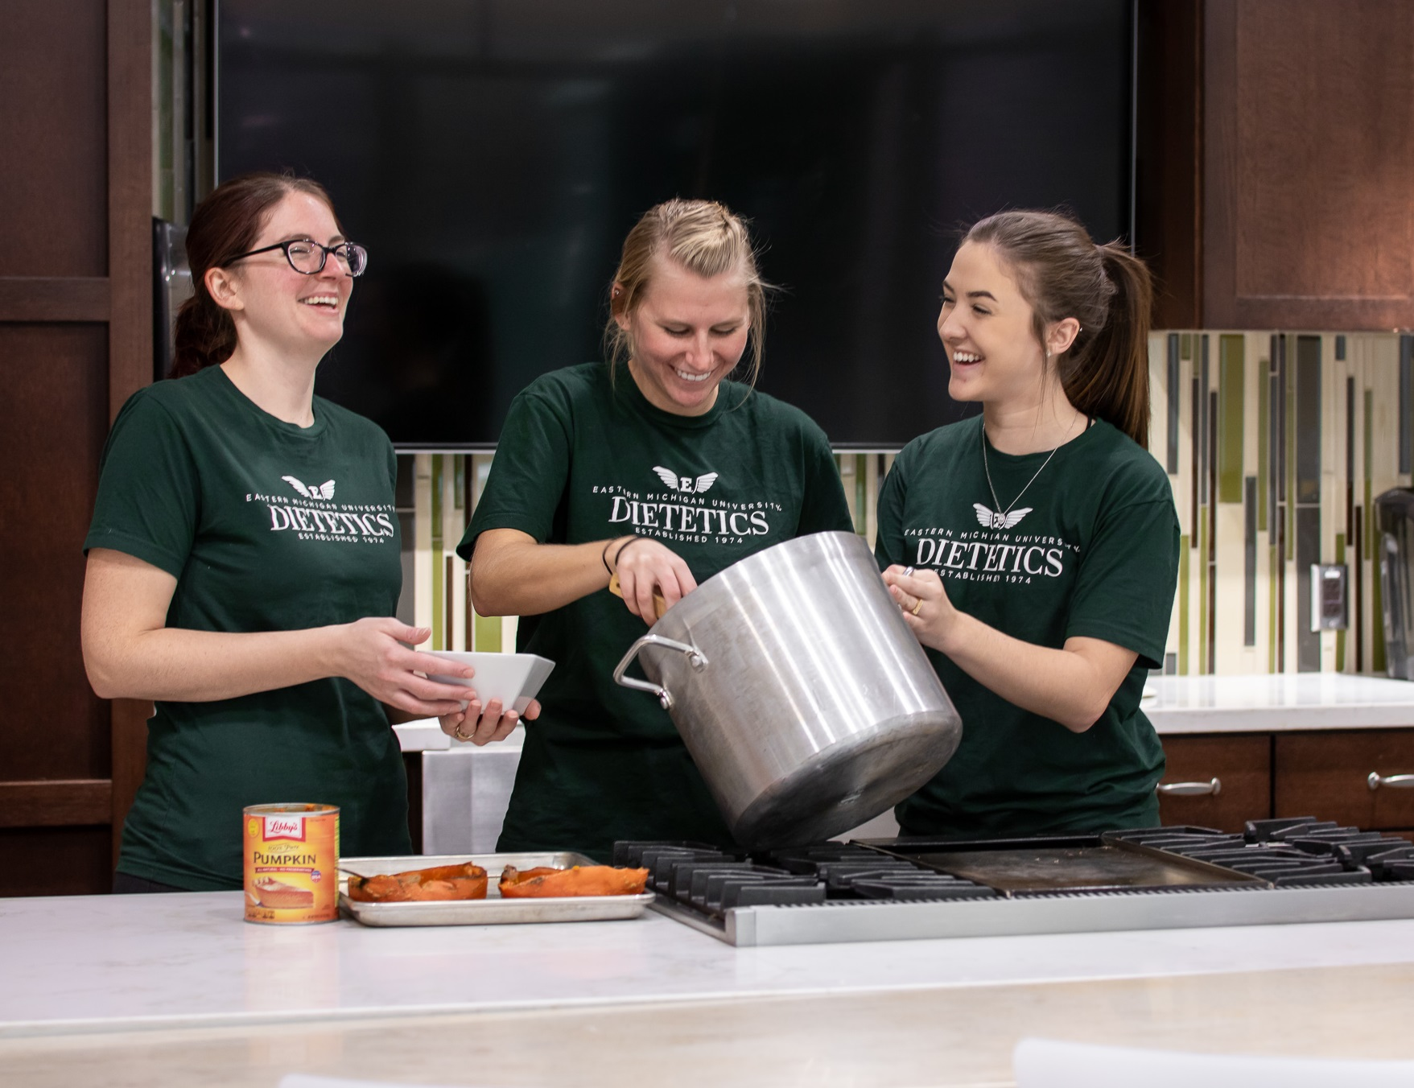
EMU Coordinated Program in Dietetics
Brief Overview 2019/2020
(In Slides and Notes)
Notes:
This Information session will provide you with a brief overview of our program.
If the information presented provides you with an appetite for more knowledge about the dietetics program at Eastern, you will want to read the Dietetics Information Packet, which is found on our EMU Dietetics Catalog Homepage. To be honest, you’ll need to read it multiple times in order to really comprehend all that’s described.
Then, read through the other pertinent documents that are listed under “Important Documents” ~ especially if you are applying to the online program. After that, compile a list of your remaining questions. These PowerPoint slides and notes will provide you with a brief overview of the Eastern MI University Coordinated Dietetics Program.

Slide 2
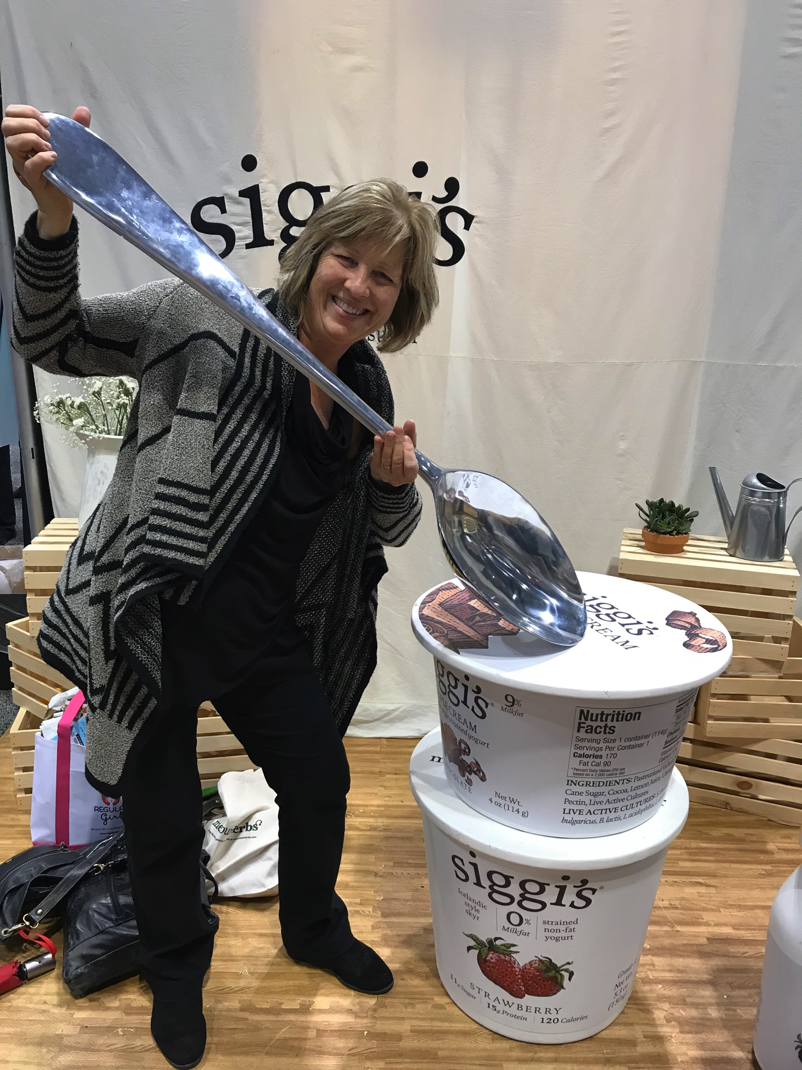
For Further Information & Questions
After Viewing This Info Session, Reading
Slide-Accompanying Notes, & Reviewing Website
Sandy Pernecky MS, RDN
Advisor, Lecturer, and co-Director of EMU Dietetics Program
dieteticsms_advising@emich.edu

Slide 3
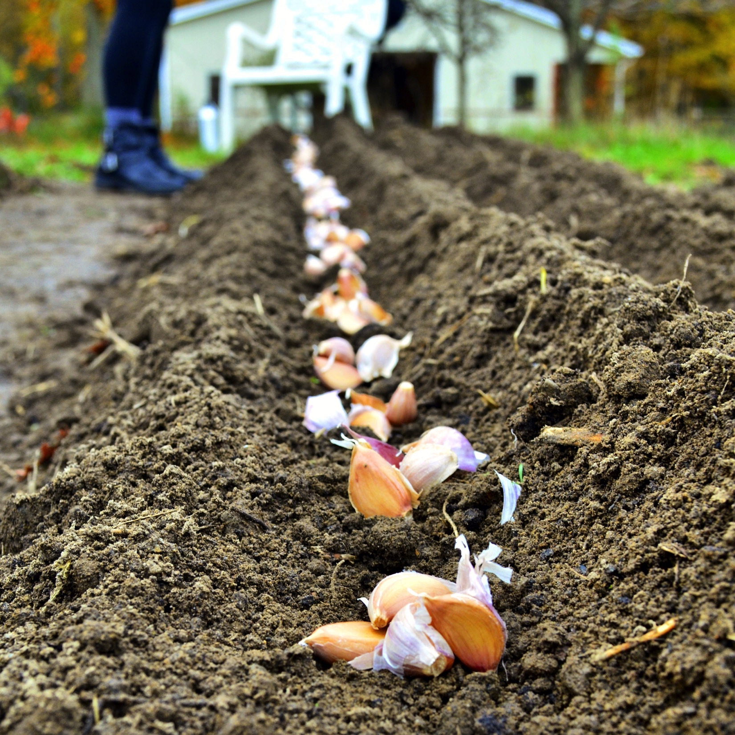
Our Program’s History
The EMU Coordinated Program (CP)of Dietetics is accredited by The Accreditation Council for Education in Nutrition and Dietetics (ACEND).
The EMU CP first sought accreditation as a Coordinated Undergraduate Program in General Dietetics from the American Dietetic Association in 1974.
EMU was the first CP in the country to offer a fully distance-online program, in 2003.
Notes:
The Coordinated Programs in Dietetics (CP) at Eastern Michigan University (EMU) have an established history of success and innovation. The EMU CP first sought accreditation as a Coordinated Undergraduate Program in General Dietetics from the American Dietetic Association in 1974. The CP has undergone many changes in the since its inception, including the selection of a Business Entrepreneur (BE) concentration, and the addition of the distance-online delivery as well as the MS-level program. In fact, EMU was the first CP in the country to offer a fully distance-online program.

Slide 4
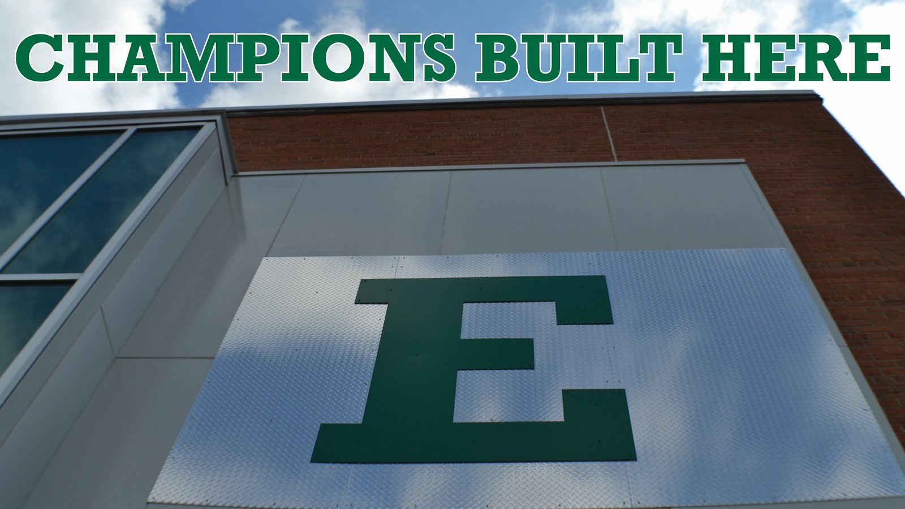
Accolades and Information
Our Program has been highly nationally ranked.
The pass rate on the RDN examination is high for our graduates and the number of graduates employed shortly after completion of our program is notable, as well.
Notes:
In 2018, the EMU Dietetics Program was ranked as #4 in the nation in a review of schools across the nation https://www.affordablecolleges.com/rankings/affordable-online-bachelors-nutrition-science-degrees/, which cited our program’s quality and affordability (https://today.emich.edu/story/news/10464). Also in 2017, the online EMU Master of Science in Dietetics and Human Nutrition was ranked as #1 among online Master’s in Nutrition programs https://www.topmastersinhealthcare.com/best/online-masters-in-nutrition/, citing the program’s ability to provide masters students with support toward individual student interests. The pass rate on the RDN examination is high for our graduates and the number of graduates employed shortly after completion of our program is notable as well.

Slide 5
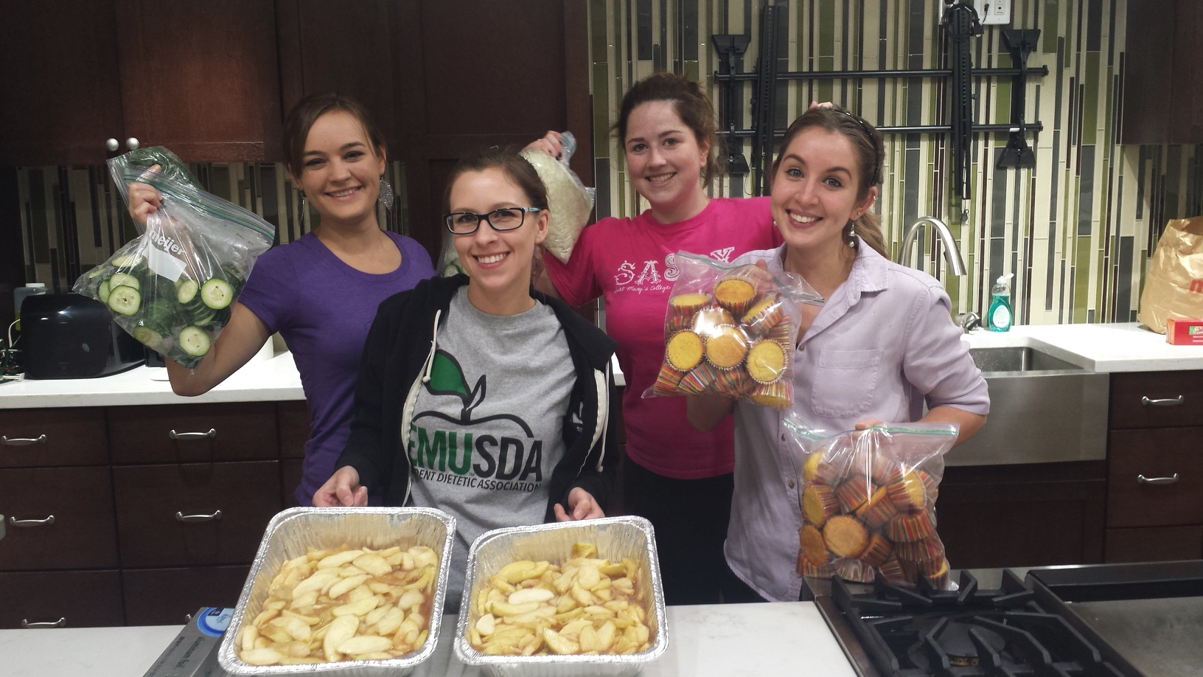
Once accepted to our program, a student can expect approximately 2 years of classes + supervised experiences.
Time to complete the EMU CP
Notes:
One of our strengths is our experienced faculty and lecturers. These educators remain devoted to the Program and derive satisfaction from investing in future practitioners. Additionally, the ability to deliver the curriculum at both the undergraduate and graduate levels as well as both on-campus and distance-online is a strong point of the program.
The methods used to teach the curriculum vary based on the delivery method of the course and the faculty member’s preferred approach. Many faculty use a variety of support tools such as audio files, video lectures, and webinars to enhance the learning of the distance-online cohort. Appealing to the learning styles of the students is key, so faculty vary their approaches and use a myriad of techniques. Faculty and staff on campus use problem-based learning, small group discussions, and research projects to enhance student learning.
Some students present their research at local, state, and national conferences. Also, students have worked with faculty to publish in peer-reviewed journals.
Eagle Nutrition Services (ENS) provides on-campus CP students with entrepreneurial‐focused supervised practice while providing nutrition services to staff, faculty, students, and the community. ENS offers nutrition counseling,
analysis of three-day food records, dual-energy x-ray absorptiometry, bioelectrical impedance analysis, and outreach on campus and in the community. The ENS Demonstration Kitchen was built in 2015 and offers students a state-of-the art space designed for culinary demonstrations and nutrition education.
The Program co-Directors, faculty and staff of the Coordinated Programs in Dietetics and M.S. in Human Nutrition at Eastern Michigan University are proud of the Dietetics and Human Nutrition program history, the students and alumni, and the strong support the programs have garnered from accreditors and the university.
The CP is housed within the EMU College of Health and Human Services (CHHS), which includes programs in numerous healthcare professions, and is dedicated to offering Interprofessional Education (IPE) opportunities to our students (https://www.emich.edu/chhs/ipe/). Dietetics and Human Nutrition program students have participated in a variety of live and simulation IPE events, both on- and off- campus, involving Social Work, Physician Assistant, Orthotics and Prosthetics, Nursing, and Physician Assistant programs.

Slide 6
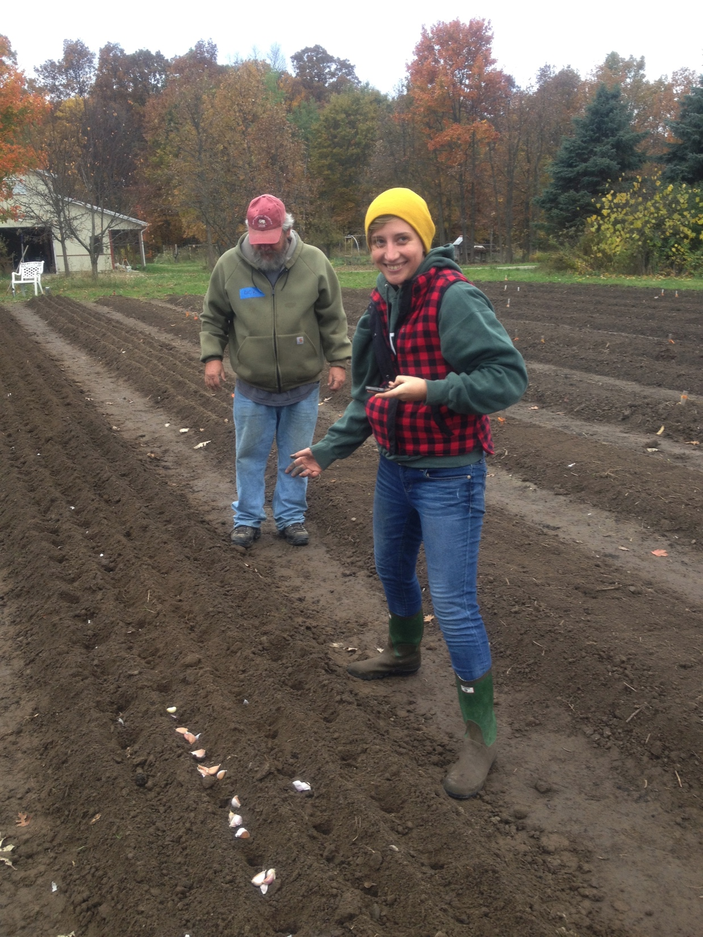
What this info session provides
This session is meant to provide you with enough knowledge to determine whether you are interested in more details about our Dietetics CP.
All information from this presentation (and much more) is available on our CP’s EMU website and EMU Catalog website.

Slide 7
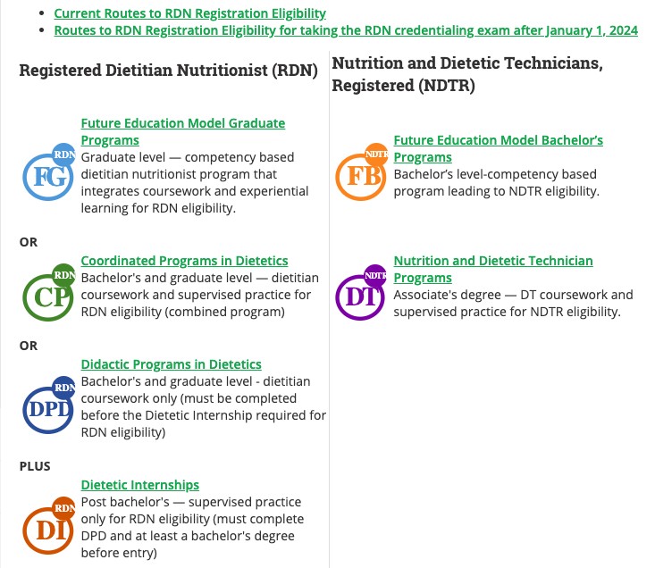
What exactly is a coordinated program for dietetics?
Follow this link to the Accreditation Council for Education in Nutrition and Dietetics:
http://www.eatrightpro.org/resources/acend/accredited-programs
Notes:
A coordinated program provides experience hours for the dietetics student concurrently with experiences in the field. After graduation, therefore, an additional dietetics internship is not required. At EMU, this allows for students to have hands-on opportunities many days of the week, with lectures on Fridays for on-campus students (or with more flexibility for online students). Basically, the dietetics student is involved in a pre-professional, registered dietitian-supervised program. This screenshot outlines the difference between a coordinated program and a didactic program, followed by an internship.

Slide 8
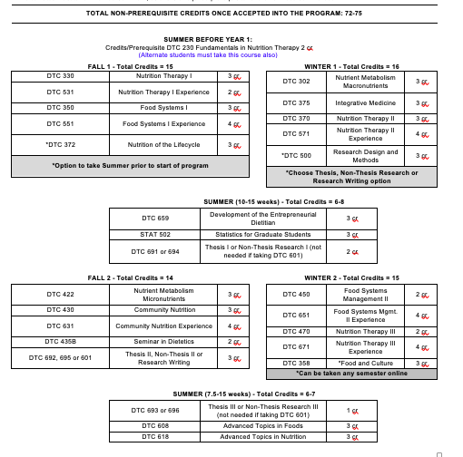
What is the typical program of study (POS) for an EMU CP student?
MS CP POS example pictured, left
Notes:
This information provides a snapshot of the typical MS program of study once a student is accepted into the EMU Dietetics Program and is found within the dietetics information packet, on our catalog webpage. This and other screenshots will be easier to read when downloaded from the Dietetics Catalog webpage Information Packet.
Notice the courses with the word experience in the title ~ those are the courses within which you’ll work through the designated 1200 supervised practice hours of our coordinated program.

Slide 9
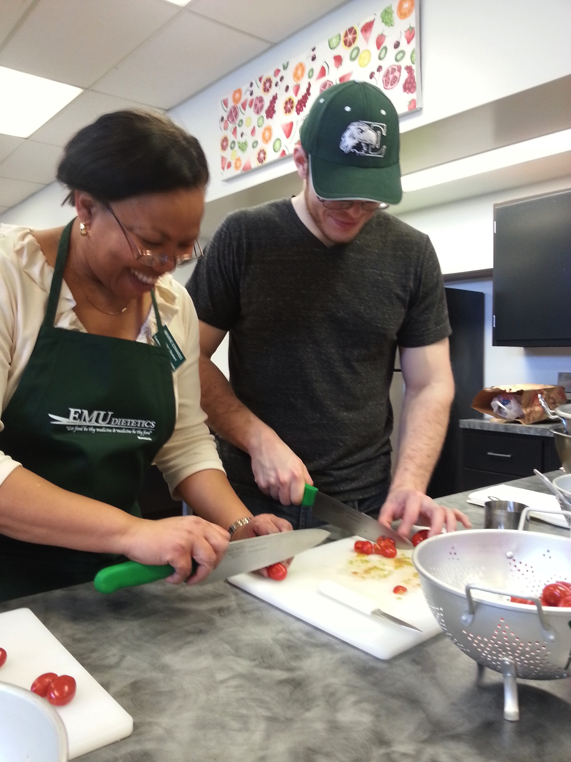
EMU’s Program is an Approximately Two Year Commitment
The EMU coordinated Program is comprised of 1200 hours of supervised experience, along with full-time coursework for Fall and Winter, for two consecutive years.
Notes:
When students complete our program, we ask for feedback...our students emphasize they want us to give prospective students as much information up front as possible ~ including that it is impossible to hold a full time job when going through this 2-year CP program.
See more information regarding this in the Dietetics Information Packet Full Time Status Page, found on our catalog webpage.

Slide 10
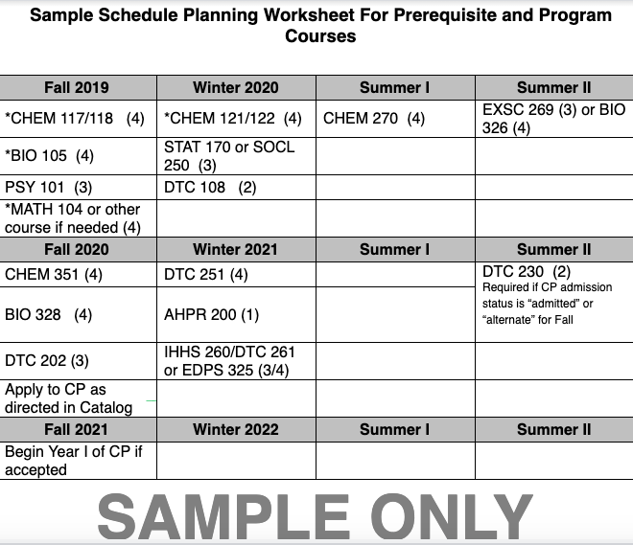
This is a marathon, not a sprint
If you need prerequisite courses, this will likely be a 3-4 year process toward graduation
Pre-application
courses due by January of application year
Cumulative GPA requirement of 2.75 (unless Prerequisite GPA 3.5 )
Pre-Application Prerequisite GPA is required to be 3.0 or higher to apply
See “Prerequisite Course List and Guidelines” Page” and
“Program of Study” pages for UG and GR
Within Dietetics Information Packet on our catalog website
Notes:
Remember this is a marathon, not a sprint! If you need prerequisite courses, completing our program will likely be a 3-4 year process. The annual January application due date determines when you may apply and start the dietetics program ~ it’s dependent on having your prerequisites done, among other requirements.
If you successfully complete your prerequisites by Fall 2020, you may apply to the program in Winter (November through January) 2021. If you are accepted into the program, your first pre-program course will be in Summer 2021 (DTC 230), with the full-time dietetics program beginning in Fall 2021.
Please also note that the current cumulative GPA required to apply to the dietetics program is 2.75 or higher ~ the pre-application prerequisite GPA needs to be 3.0.
The minimum prerequisite GPA (pre-application courses only) required for application is increasing from 2.75 to 3.0, starting with the January 2019 application. Exceptions will be made on a case by case basis for applicants advised prior to July 2018 regarding the previous 2.75 minimum prerequisite GPA requirement and who provide evidence of their inquiry/work towards EMU’s Dietetics Program prior to July 2018.
If a student does not meet the 2.75 minimum overall/cumulative GPA requirement, they may retain eligibility by carrying a prerequisite GPA (pre-application courses only) of 3.5 or higher.

Slide 11
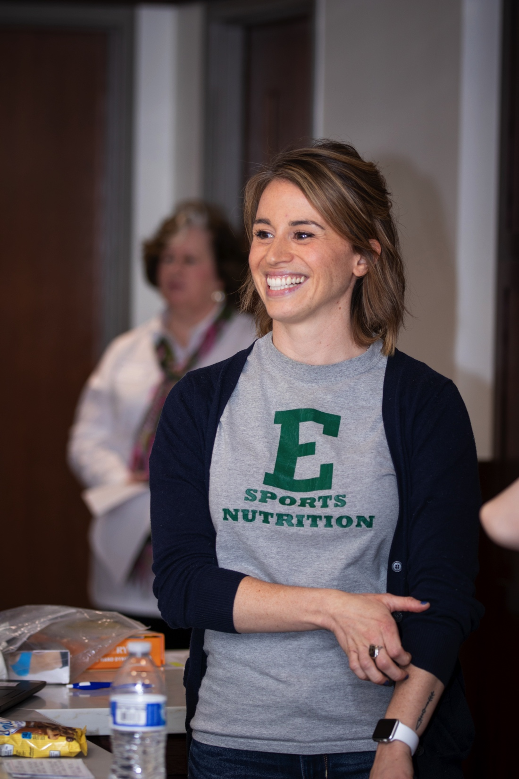
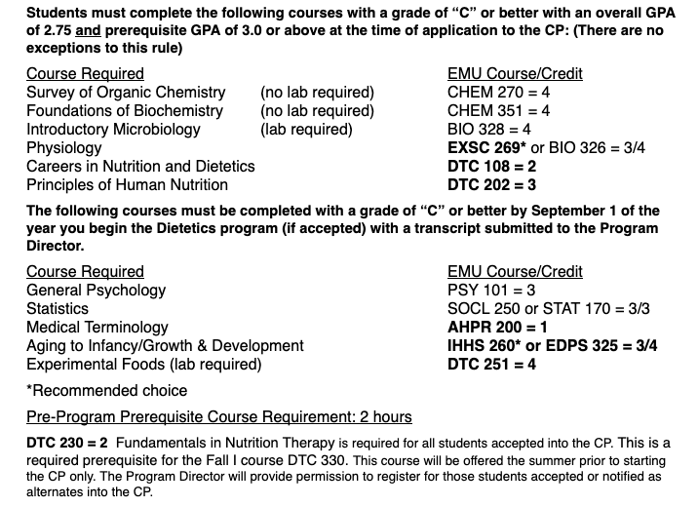
Prerequisites
Notes:
Our prerequisites are split into 2 categories: before and after the dietetics application.
You can discuss this during advising ~ this is an area where students have a lot of questions. Many of these courses can be taken online or at a local college or at EMU ~ as long as pre-approved ~ see the Dietetics Information Packet (for some preapproved courses). Address your questions at 1:1 advising/phone advising sessions, after you apply and are accepted to EMU.

Slide 12
May I transfer Prerequisites?
Yes/Maybe…
  Prerequisite courses not taken at EMU need to be assessed through the initial admission transcript review or approved/pre-approved for equivalency by syllabus review by faculty through your EMU advisor
  OR if taken in MI or OH, they may be listed on the EMU Transfer Equivalency List
  Any previously taken prerequisite courses need to additionally fall within the time-since-taken guidelines

Slide 13
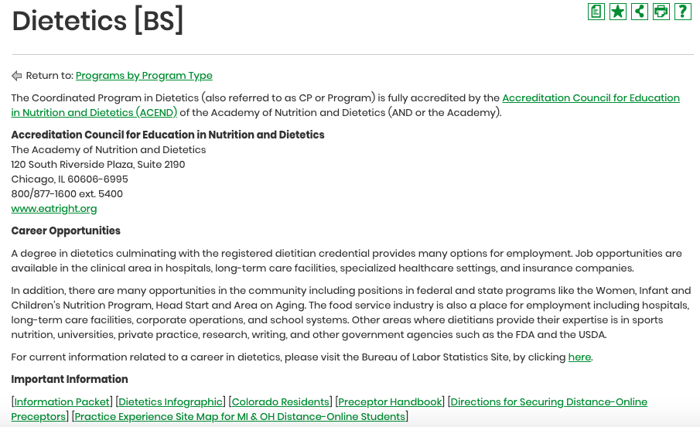
This is the Dietetics BS page
(read all documents online)
Notes:
This is where you find the information packet and more...Make sure to read ALL the documents comprehensively.

Slide 14
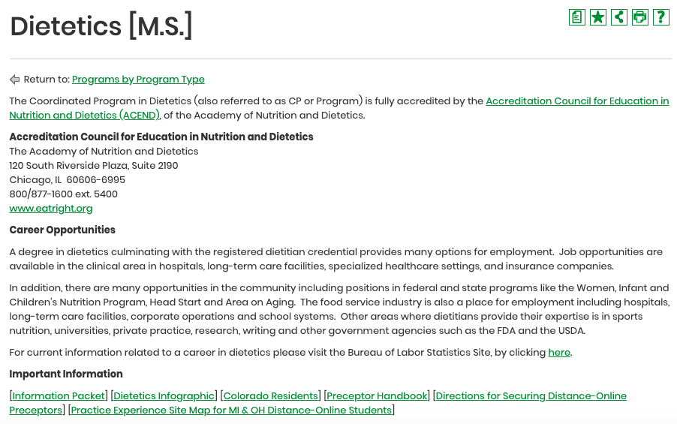
This is the Dietetics MS Page (read all documents online)
Notes:
This is the MS version of the webpage where you can find the same information packet.

Slide 15
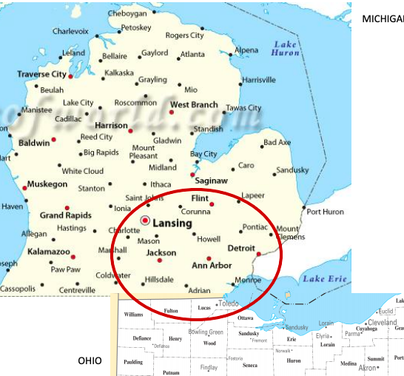
Distance-Online Students and Supervised Practice Experience (SPE) Sites
Distance-online students are required to arrange their 1200 SPE hours outside of the red circle, with requirements for certain placements prior to applying to the CP.
Additional information is available on the catalog website.
Notes:
On-Campus students are provided with preceptors for experiences through our program,
Because we place our campus students, online students are required to find preceptors their experiences outside of the campus area (outside the red line on the map)
Both on-campus and online students require independent transportation
to their experience sites.

Slide 16
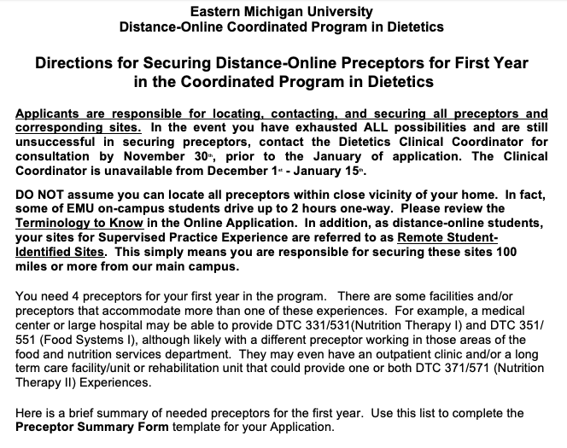
Distance-Online Students Only
Read through this section of the Securing Preceptors document online, to understand specifics about securing preceptors (after careful review, contact Diane Reynolds, RD, Dietetics Program Clinical Coordinator, (dreynol2@emich.edu) with specific questions)
Notes:
Some of the information you’ll find is geared toward online students.
Online students will need to secure some of their preceptors prior to applying to the program. For detailed information, read the dietetics information packet and online application first ~ and contact Diane Reynolds(dreynol2@emich.edu) with additional questions.

Slide 17
Tuition and Fees
For this information, please see Information Packet on Catalog Website, as well as Tuition Calculator
Eastern Michigan University’s (EMU) Fully Online Dietetics Program, whether taken at Bachelor’s or Master’s level, is charged to students at Michigan resident rates! See https://www.emich.edu/sbs/basics/tuition.php. Please note that all courses taken online have associated technology support fees.
All questions about financial aid should be addressed to EMU’s Financial Aid Department

Slide 18
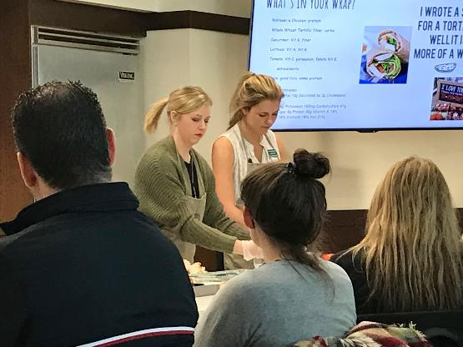
Next, is the process for eligibility to apply the EMU CP...
Notes:
Here’s a quick overview of the entire process

Slide 19
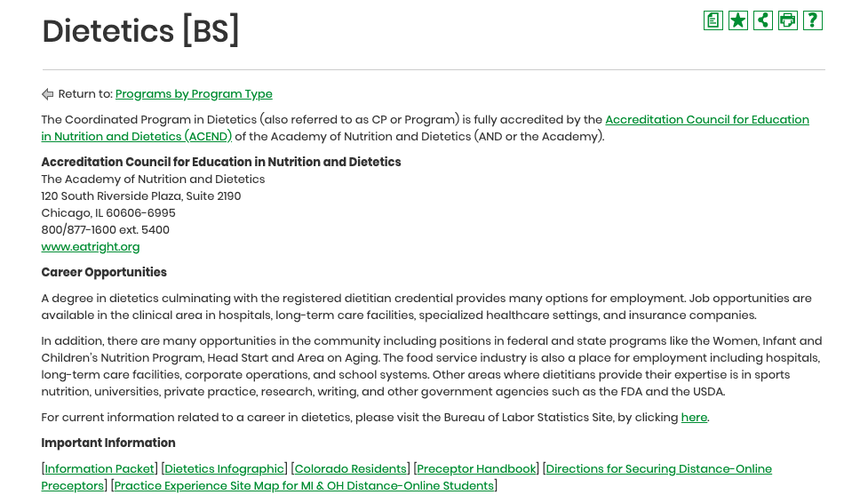
Thoroughly and comprehensively review all posted documents on EMU catalog website for Dietetics
#1
Link to: EMU Catalog Academic Program Page
Notes:
1st, you need to thoroughly and comprehensively review all posted documents on the EMU Catalog website for dietetics.
This is the bottom of the catalog webpage you were shown earlier.

Slide 20
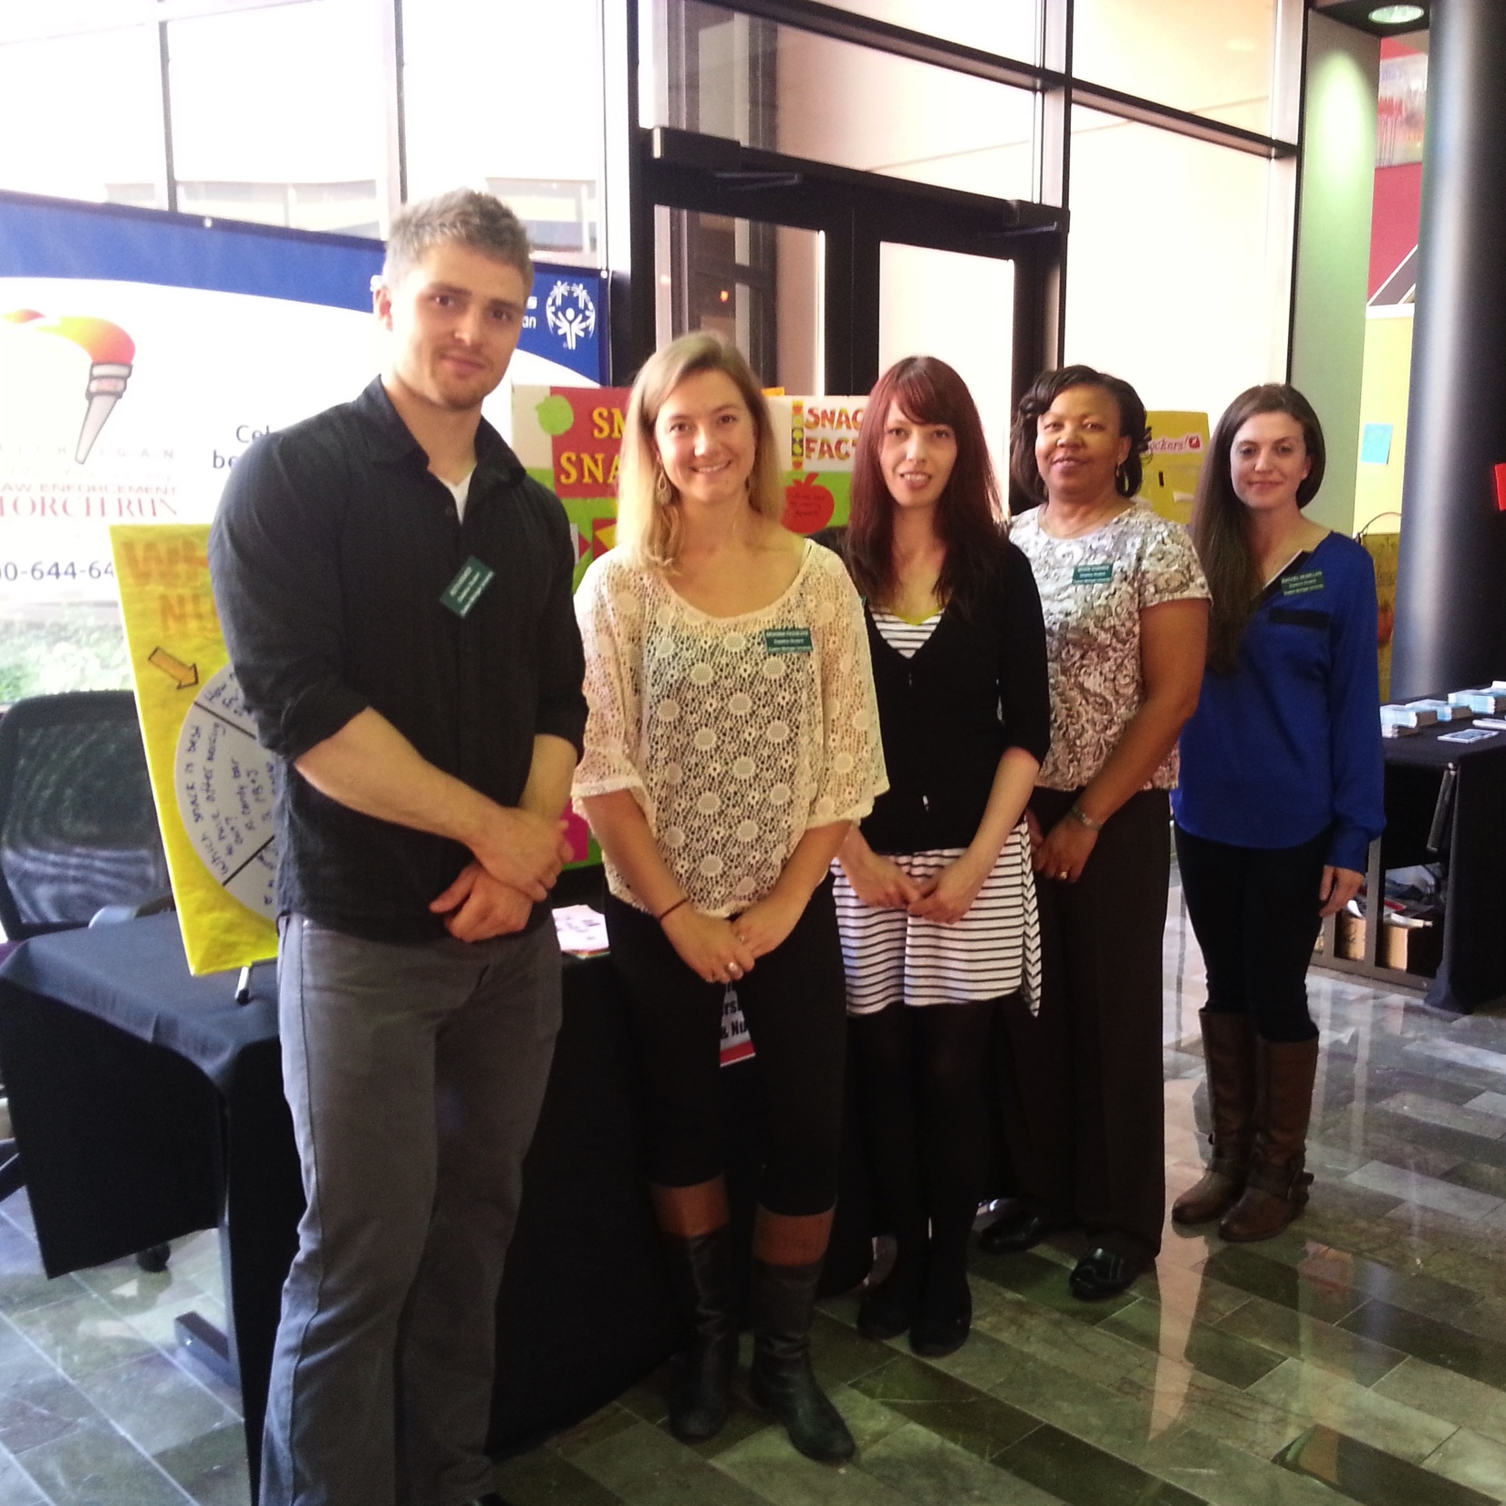
#2
Apply to EMU
Apply to EMU in order to have your previous transcripts as well as potential courses reviewed, as well as to receive advising and eventually be eligible to apply to the EMU CP
  Apply initially as Bachelors or 2nd Bachelor’s of Science with Dietetic Intent (not MS ~ this occurs after acceptance to the CP)
  Provide official transcripts from all former colleges and universities to EMU Admissions
Notes:
2nd ~ Apply to EMU
As Bachelors of Science or 2nd Bachelor’s
As Dietetic Intent Major AND provide your
official transcripts from all former colleges and universities

Slide 21
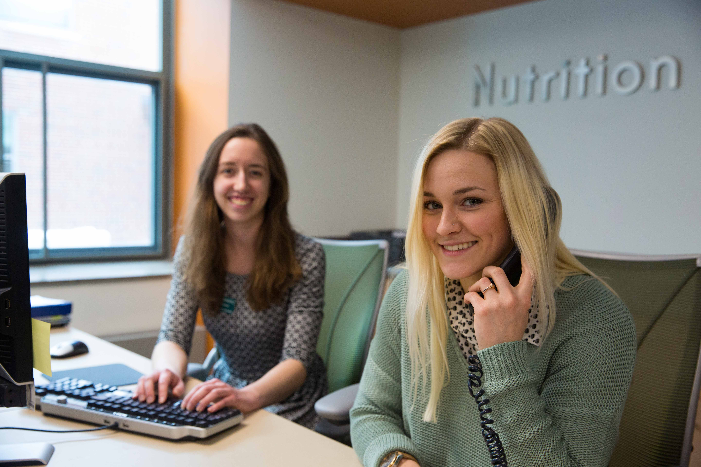
#3
Transcript Review
After notification of admission to EMU, you may email CHHS advising for transcript evaluation and a program of study
Notes:
Once admitted to EMU, CHHS Advising: chhsadvising@emich.edu to have your transcript evaluated, and be provided a program of study.

Slide 22
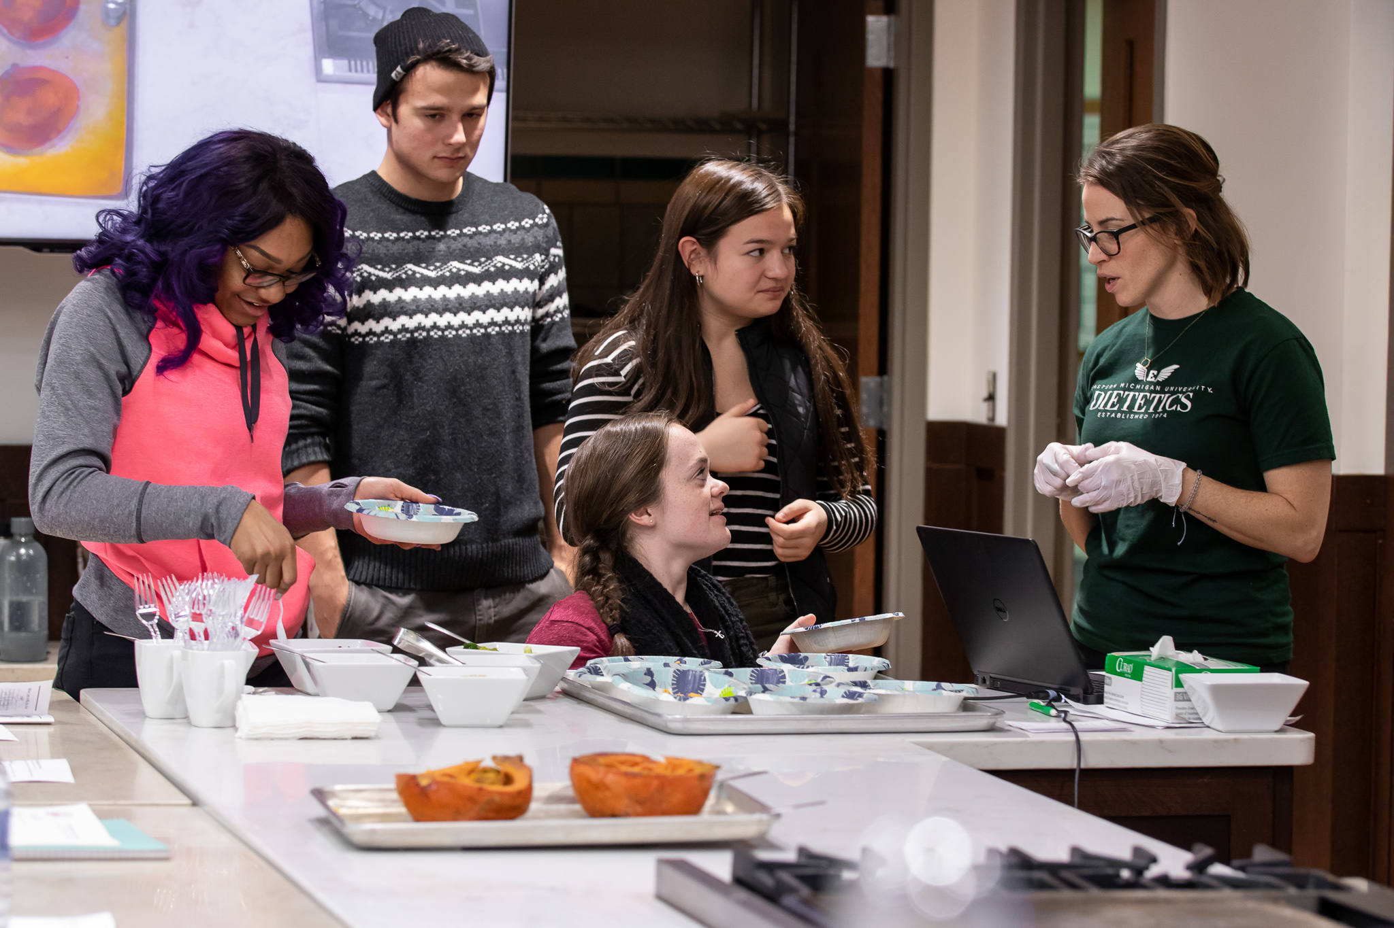
#4
Successfully Complete Prerequisite Courses
Earn grades of C or higher and pre-application prerequisite course GPA of 3.0 or higher
Notes:
4th ~ you need to successfully complete prerequisite courses ~ 3.0 prerequisite GPA is required
The dietetics information packet provides the list of prerequisites: C or higher is required in all courses, with the minimum GPA of 3.0 for the pre-application prerequisites.

Slide 23
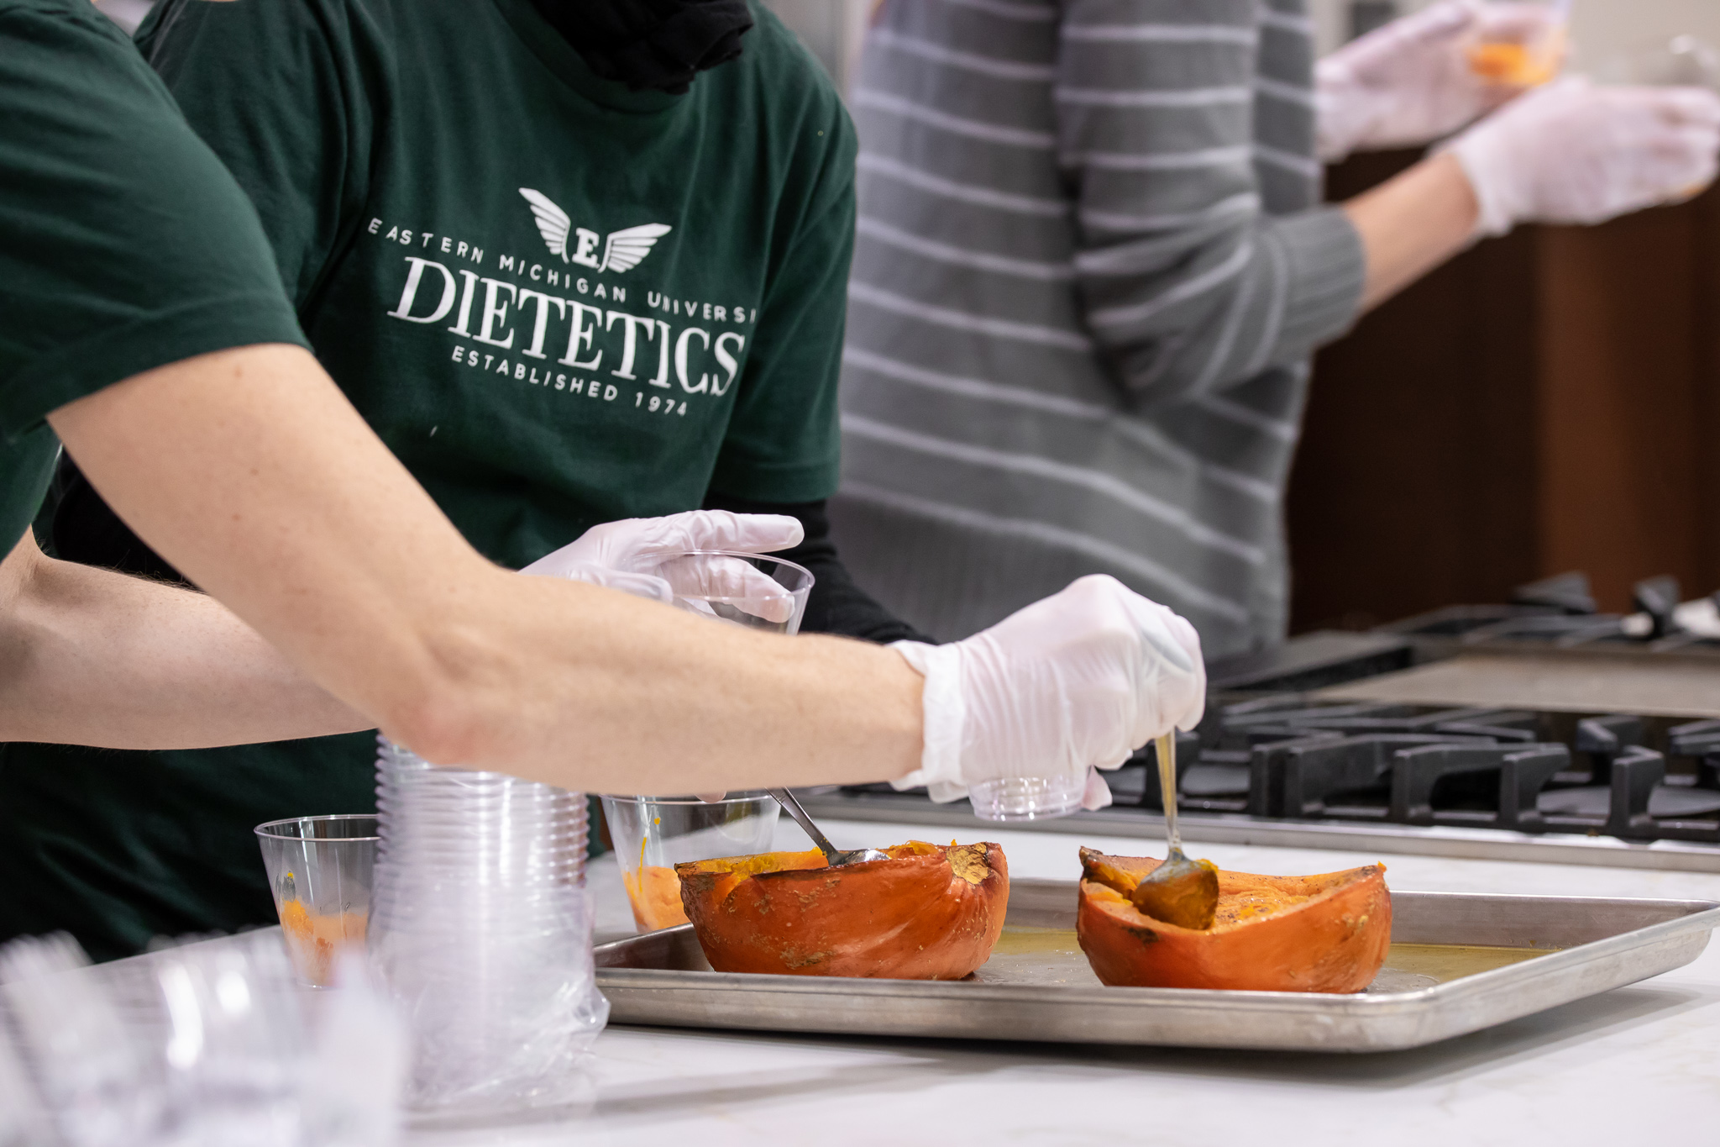
#5
Volunteer
Volunteer a minimum of 24 hours in a nutrition/dietetics, healthcare, or food-related area, while completing the required form each time (with supervisor’s signature)

Slide 24
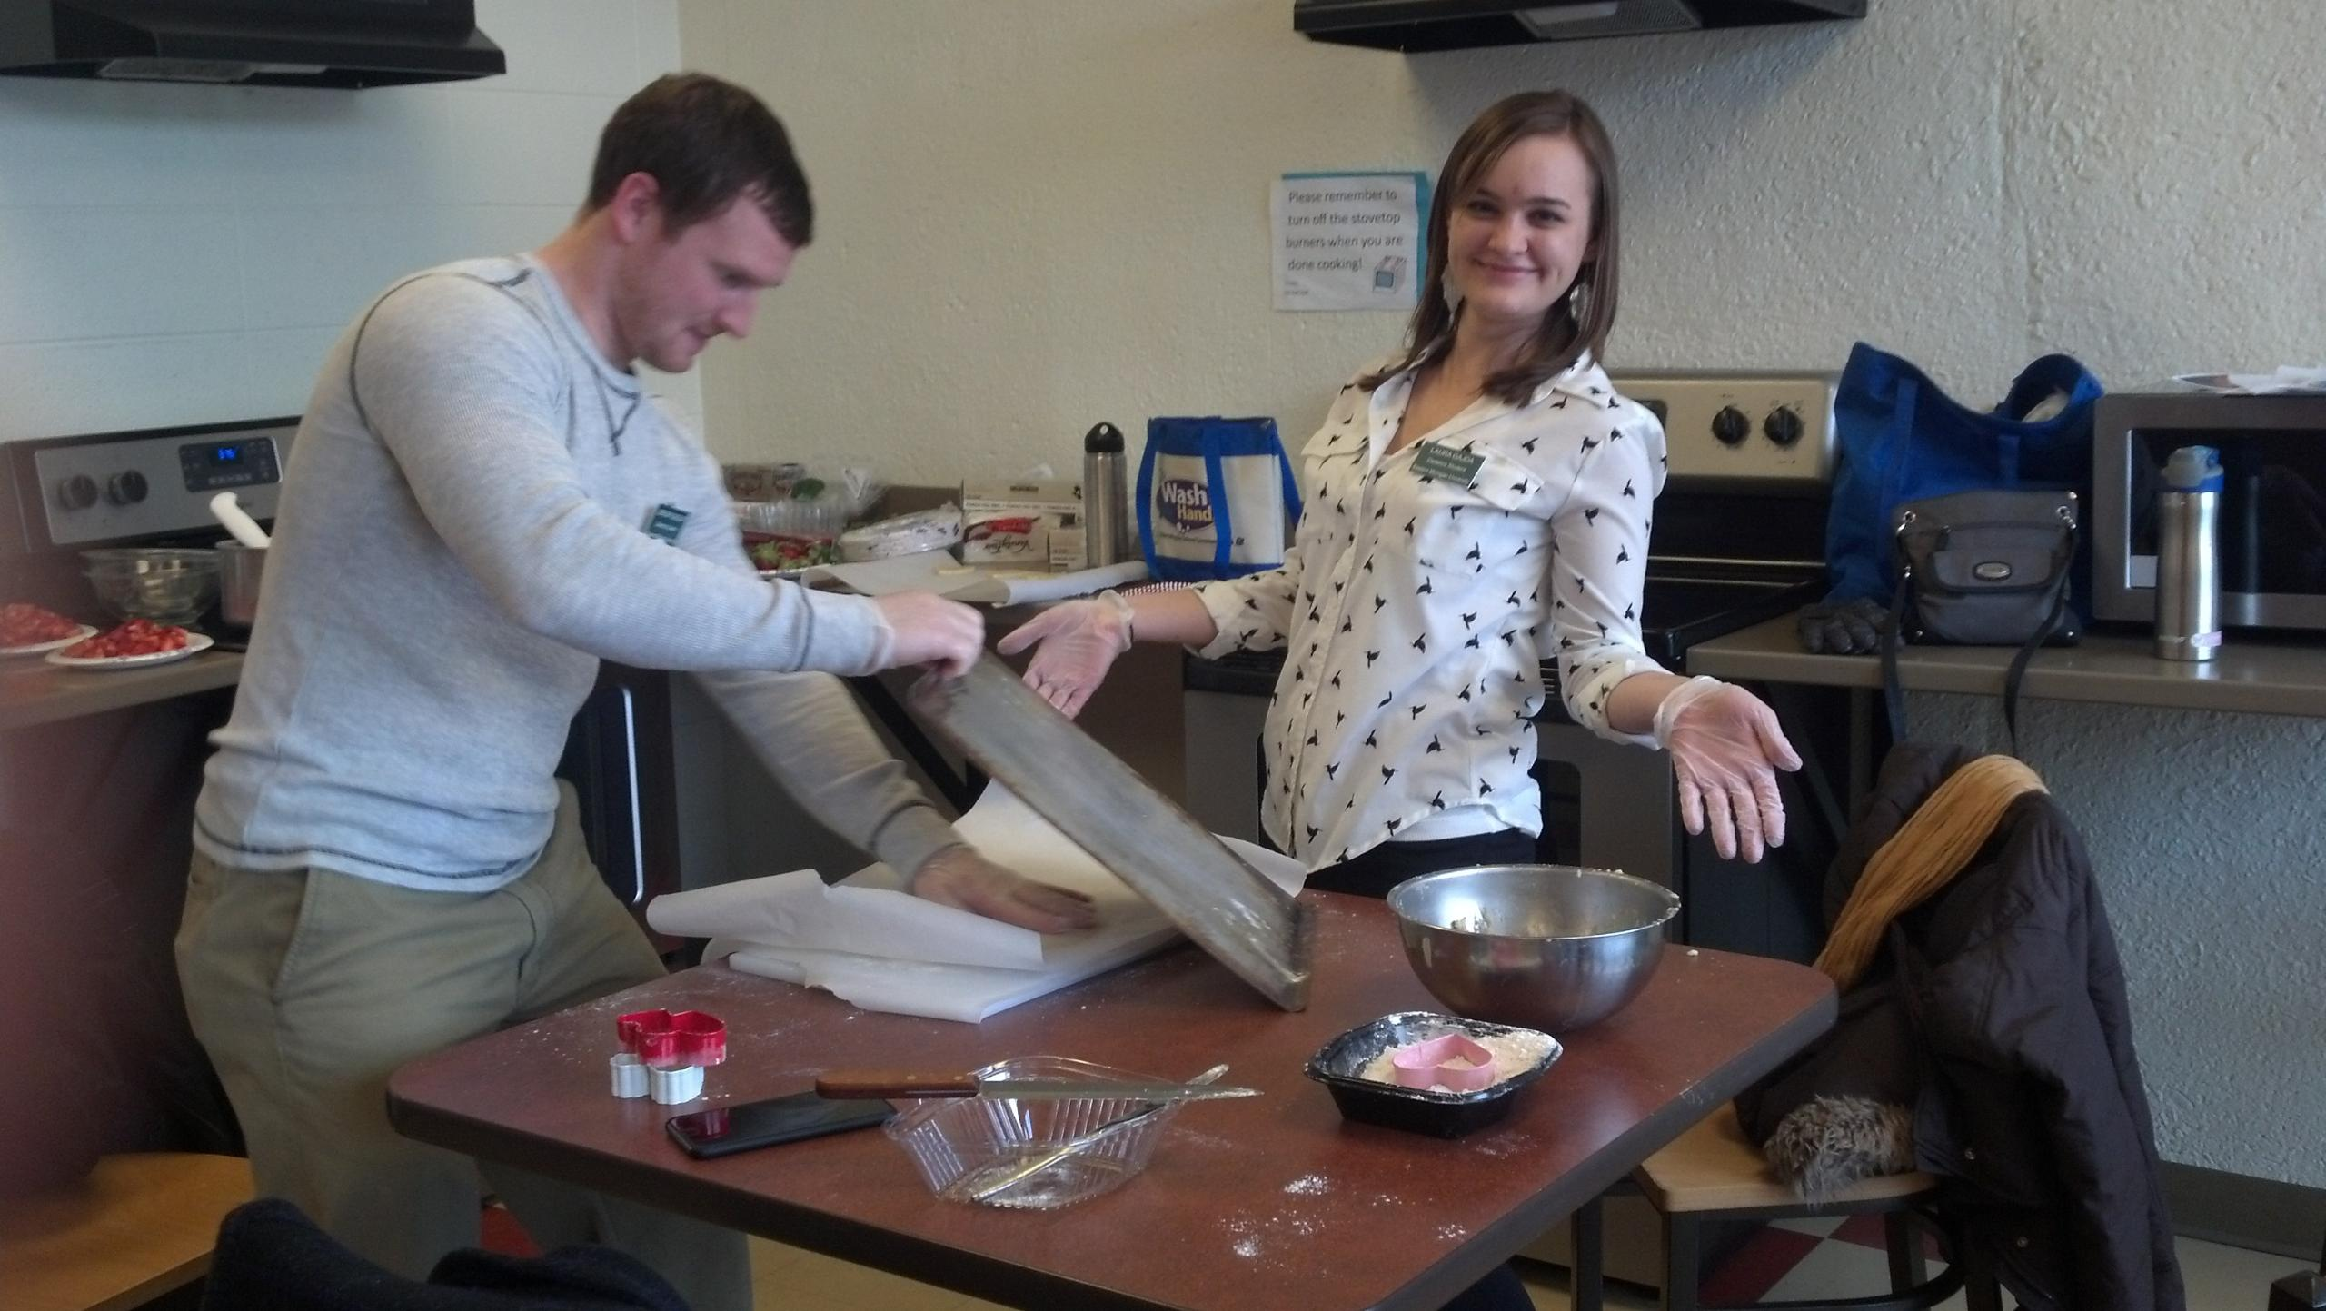
#6
Stay on Track
Habitually review the EMU Dietetics website
If you plan to be a distance/online student, contact and secure preceptors in advance
Notes:
Check the EMU Dietetics Catalog website each term, for any updates
Know the documents and process for application to the program
Ask questions of your advisor
as questions arise

Slide 25

#7
Apply
Once all pre-application prerequisite courses are successfully completed and additional requirements are met, start EMU CP 2-step online application process between November 1 and January 1 (specific application information available on catalog website; dates may vary annually)
Best wishes as you begin this journey!
Notes:
When all has been completed to be eligible for the Dietetics Program at EMU, complete all components of the application and provide these as required, according to the website, paying attention to all details, including the deadline
Best wishes as you begin this journey!

Slide 26
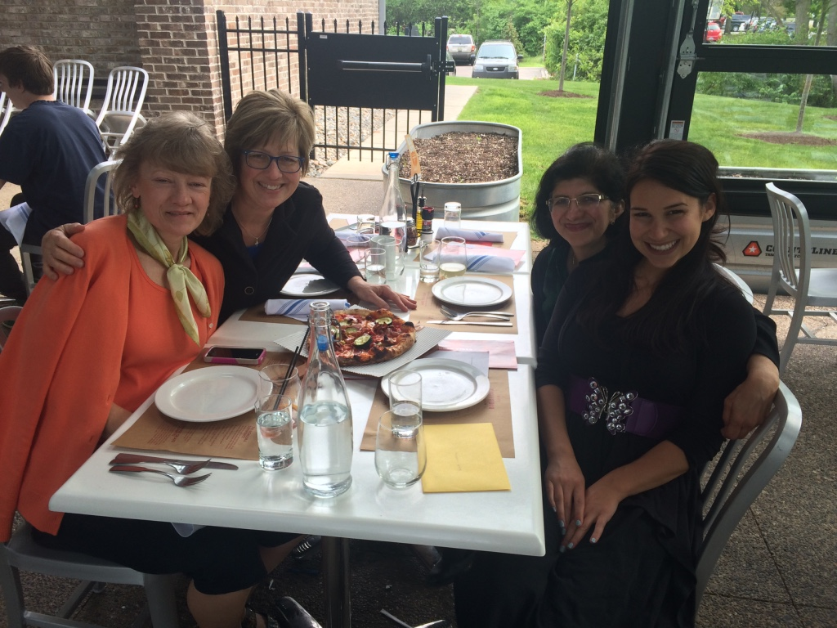
Additional Information…
If you’re interested, and would like additional information about the EMU CP, the next few slides provide insights from and about a few of our numerous, successful alumni…

Slide 27
Testimonial
I am so grateful I made the decision to take the dietetics program at EMU. The structure allowed me to effectively learn and gain experience to start practicing as a registered dietitian right after graduation. I had the opportunity to work directly with professors to prepare me for the licensing exam and confidently approach my career. I owe it to EMU’s dietetics program for a great educational experience and guiding me to achieve my dream career
Gina Worful, MS, RD
Registered Dietitian at Cal-a-Vie Health Spa
Speaker and Published Author

Slide 28
Testimonial
As a graduate of the Eastern Michigan University Coordinated Program in Dietetics, I have been able to stand out among my professional peers. The strong management components, well-structured coursework, stringent preceptor expectations, and individualized practice experiences speak to this quality program. Having worked in multiple practice environments since graduation, I never lacked in the requisite knowledge or ability to advance my skillset. Without hesitation I returned to EMU to pursue a Master’s in Human Nutrition.
Patrick Johnson, MS RD CNSC CD
Undergrad CPD 2012
CNSC Certification 2015
HN Masters 2018

Slide 29
Testimonial
"EMU’s Dietetics Program is one-of-a-kind! Even for students in the distance program such as myself, the department staff members are very personal and attentive to our educational needs. I now have friends and colleague connections from all over the country! Shortly after graduating, I was offered a position at my clinical Supervised Practice Experience site. I credit EMU’s comprehensive program for being well-rounded in the field of dietetics and I would not trade my experience for anything!
Ashley Runge MS, RD
Renal Dietitian at Fresenius Kidney Care

Slide 30
Testimonial
The EMU coordinated dietetics program sets a high standard! My preceptors constantly commented on the comprehensiveness of EMU’s program, compared to other programs they had encountered. The challenging courses, the supportive teaching staff, and the engaging environment helped me to develop the critical thinking skills necessary for a career in dietetics. I passed my RD exam and was employed within three months of completing the graduate program! Thank you, EMU!
Melissa Flynn, MS, RD, LDN
Dietitian at Wilmington Treatment Center – A recovery hospital
And Owner of Innovate Nutrition

Slide 31
Testimonial
The CP in Dietetics was an opportunity for me to change careers and pursue my passion for nutrition and healthcare. I was challenged intellectually and I also grew as a person and as a professional. The academic department as well as my preceptors were very supportive and encouraging. I was well prepared for the RD exam once I completed my studies and I am proud to be a dietitian and alumni of this fantastic program.
Raquel Carter, RDN
Clinical Nutrition Manager at Unidine

Slide 32
Testimonial
I wanted to give an update on my recent career move. After I graduated I moved to Florida and began working for a consultant company, one of the accounts I worked in was Coral Gables Hospital, who has just recently bought out my contract and I am now taking on the role of Chief Clinical Dietitian/ CNM in this small hospital. I want to say that since being in the field I noticed that my clinical skills have far surpassed new and seasoned dietitians who have been around for years and I can attribute this to the dietetics program at Eastern Michigan University. I cannot be more proud to tell people that I have graduated from this program as I believe it has prepared me greatly for the real world of dietetics and has enabled me to move up so fast. I am very excited to take on this role. I want to thank you all for all that you do and for continuing to give back to the future dietitians. I am proud to announce that at this time I am being groomed to take over the role as the Director of the Food and Nutrition Department.
Samantha Sanner, RDN, LDN

Slide 33

More Information
For more general information about our program and faculty, please visit this website
LinkedIn
Recent EMU Dietetics Newsletters:
  https://spark.adobe.com/page/jTfhXDQRNdZ4x/
  https://spark.adobe.com/page/kkUQlqhA7S1em/

